Slide 1

CHURN PREDICTION ANALYSIS
(CAPSTONE PROJECT)
BY
CANSU TEZCAN FERNANDEZ GUTIERREZ

Slide 2
EXECUTIVE SUMMARY
Introduction: Telco Customer Churn
With the rapid evolution of the telecommunications industry, service providers are under constant pressure to expand their subscriber base while navigating fierce competition. In this environment, retaining existing customers has become a critical challenge , especially given that acquiring a new customer is significantly more costly than keeping a current one.
To address this, telecom companies must leverage advanced analytics to understand customer behaviour and predict churn. This project explores how data-driven models can identify which customers are likely to leave and why empowering businesses to act before it's too late.
Research Objectives
Using a rich dataset containing customer-level service usage information, this analysis aims to answer three key business questions:
What variables are contributing to customer churn?
Who are the customers most likely to churn?
What actions can be taken to prevent churn?
Analytical Approach
I deployed a two-tiered strategy:
Random Forest for immediate churn reduction with low cost and complexity
XGBoost with SHAP values for quarterly deep dives into churn drivers, enabling transparent reporting and targeted retention campaigns
These models learn from historical behaviour and highlight top churn indicators such as price sensitivity, declining usage, and support ticket frequency giving us both fast wins and long-term strategic control.

Slide 3
Data Understanding & Cleaning
Dataset Overview:
Source: Telco customer churn dataset Telco customer churn: IBM dataset
Size: 7043 observations with 33 variables
Target: Churn Value (binary)
Cleaning Steps:
Removed duplicates, checked for missing values, and identified outliers
Converted categorical values to binary where appropriate
Encoded categorical variables using a combination of:
Hierarchical encoding for high cardinality categorical feature
One-hot encoding for categorical features
Handled missing values through imputation techniques
Scaled numerical variables to ensure consistent feature ranges
Balanced the target variable using SMOTE (Synthetic Minority Over-sampling Technique)
Split the dataset into training and testing sets for model evaluation

Slide 4
EDA Summary & Key Insights
Variables Contributing to Customer Churn (Complete Ranking by Impact)
Highest Impact Variables:
Contract Type (Cramér's V: 0.410): Most significant predictor - month-to-month contracts show 42.7% churn vs. 2.8% for two-year contracts
Tenure (correlation: -0.352): Strong negative relationship - early customers at highest risk, with critical 1-3 month vulnerability period
High Impact Variables:
Add-on Services: Online Security (0.347), Tech Support (0.343), Online Backup (0.292), Device Protection (0.281) - non-subscribers significantly more likely to churn
Internet Service Type (0.322): Fiber Optic users show 41.9% churn - highest among service types
Payment Method (0.303): Manual payment users more vulnerable than automatic payment customers
Moderate Impact Variables:
Customer Demographics: Dependents (0.248), Partner status (0.150), Senior Citizen status (0.150)
Streaming Services: TV (0.230) and Movies (0.230) - moderate influence on retention
Monthly Charges (0.193): Positive correlation - higher charges associated with increased churn risk
Total Charges (-0.199): Negative correlation - higher lifetime spending indicates loyalty
Low Impact Variables:
Paperless Billing (0.191)
Geographic factors: City (0.122), Lat-Long (0.116) - Location: High-churn zip codes & rural areas
Multiple Lines (0.036)
No Impact Variables:
Phone Service (0.000), Gender (0.000)

Slide 5
EDA Summary & Key Insights (Cont.)
Enhanced High-Risk Customer Profiles
Critical Risk Segments (Prioritized):
New month-to-month customers - Combination of highest risk factors (contract flexibility + early tenure)
Fiber Optic subscribers without add-ons - High-value segment with service quality sensitivity
Senior citizens on short-term contracts - Demographic and contract risk convergence
High monthly charge customers without engagement - Paying premium but not utilizing services
Single customers without dependents in first 3 months - Multiple vulnerability factors
Secondary Risk Indicators:
Manual payment method users (especially electronic/mailed checks)
Non-subscribers to protective services (71% lack backup, 63% no security)
Customers in specific zip codes (90020, 90005, 90010) with localized issues

Slide 6
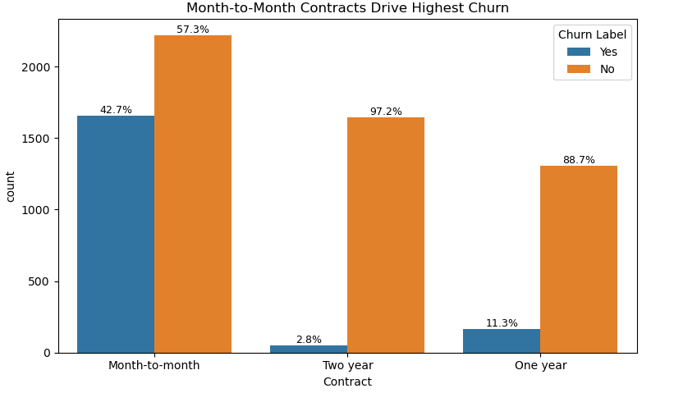
Data Insight
Contract type is a key variable contributing to customer churn, with month-to-month subscribers who make up 55% of the customer base showing the highest churn rate at 42.7%. These customers are more likely to leave due to their preference for flexibility and lower commitment, making them the most at-risk group. In contrast, churn drops significantly among those on longer-term contracts, with just 11.3% for one-year and 2.8% for two-year plans, indicating that longer commitments foster greater loyalty.
To reduce churn, businesses should target month-to-month users with personalized incentives such as discounts or premium features to encourage upgrades, while also reinforcing the value proposition for existing one-year customers to further improve retention.

Slide 7
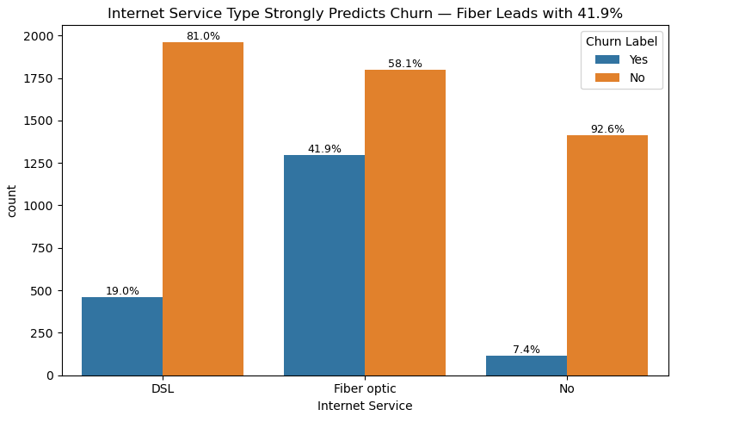
Data Insight
Customer churn is strongly influenced by the type of internet service, with Fiber Optic emerging as both the most popular and the most unstable segment holding a 41.9% churn rate and a correlation of 0.322 with churn. These customers, who are likely tech-savvy and high-value, may be more sensitive to service quality and competitive offerings, making them the most likely to leave. DSL users show moderate churn at 19.0%, while customers without internet service are the most loyal, with only 7.4% churn.
To reduce churn, companies should focus on improving service quality and satisfaction for Fiber Optic users, explore the motivations of non-internet users to convert them into subscribers, and promote DSL as a reliable alternative for retention.

Slide 8
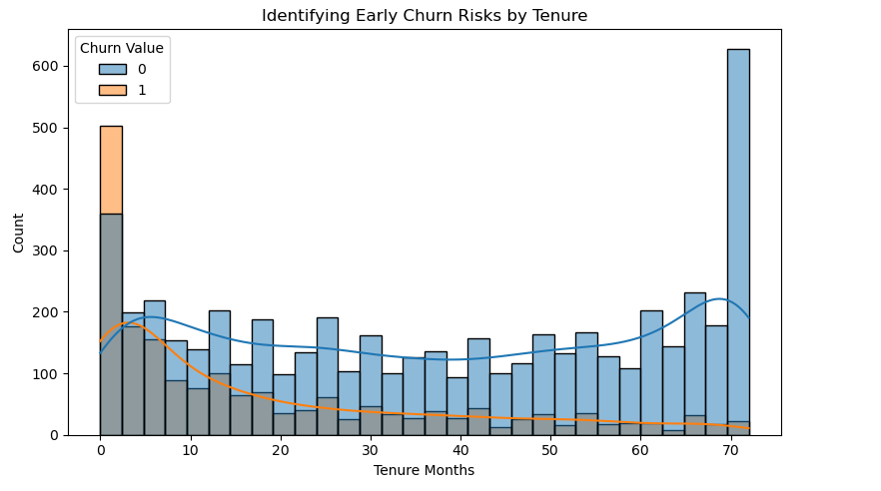
Data Insight
The data shows a wide range of customer lifespans from brand-new users to those who’ve stayed for up to six years. Notably, there are two key groups: those who leave within the first month, and those who remain loyal over the long term. The sharp decline after month one points to a challenge with early retention, as most customer losses happen within the first three months.
Customers who stay beyond 10 to 15 months are far more likely to continue using the service, highlighting how critical the early experience is.
To improve retention, businesses should prioritize smooth onboarding, timely support, and personalized engagement during the initial months.
In short, how long a customer stays is a strong indicator of loyalty and a valuable metric for understanding and reducing churn.

Slide 9
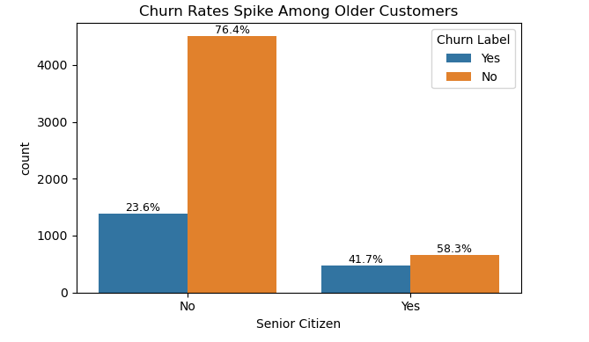
Data Insight
Customer churn is notably influenced by age, with senior citizens (65+) showing a significantly higher churn rate of 41.7%, nearly double that of non-seniors at 23.6%. This makes age a meaningful predictor of attrition, supported by a moderate correlation score of 0.150. Seniors, though a minority in the customer base, are more likely to leave due to potential challenges with digital interfaces or unmet support needs.
To reduce churn, companies should implement targeted retention strategies such as personalized outreach, simplified user experiences, enhanced tech support, and bundled service offerings tailored to senior customers. Meanwhile, product design and marketing should continue to cater to the tech-savvy majority while remaining inclusive.

Slide 10
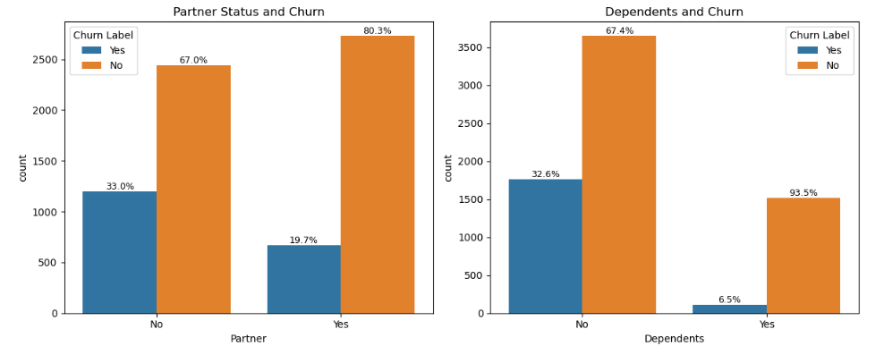
Data Insight
Partner Status and Churn
Higher churn among customers without a partner, 33.0% of customers without a partner have churned, compared to just 19.7% of those with a partner. Partnership linked to retention, 80.3% of partnered customers remain with the company, versus 67.0% of those without a partner. Having a partner appears to be a stabilizing factor, potentially reflecting greater loyalty or life-stage stability that reduces the likelihood of churn.
Dependents and Churn
Significantly higher churn among customers without dependents, 32.6% of customers without dependents have churned, while only 6.5% of those with dependents have left. Dependents strongly associated with retention, An impressive 93.5% of customers with dependents stayed, compared to 67.4% of those without. Customers with dependents are far more likely to remain, possibly due to a greater need for consistent service to support their households.
Summary
Customers who have a partner and/or dependents are substantially less likely to churn. In contrast, those without either show significantly higher churn rates, suggesting that personal relationships and family responsibilities may play a key role in customer retention.

Slide 11
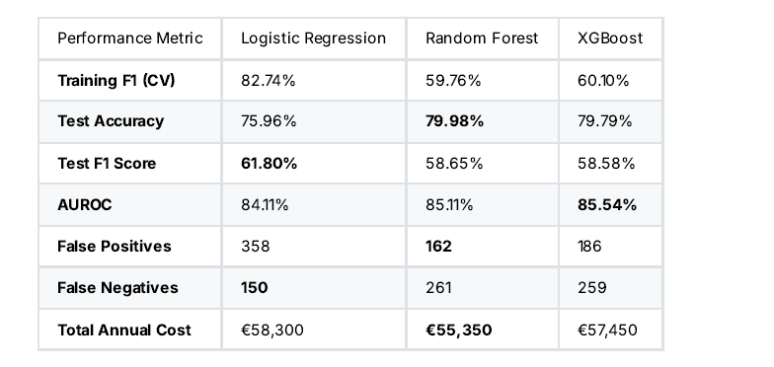
Modelling Overview
Models Compared:
Dummy Classifier
Logistic Regression
Random Forest
XGBoost
Metrics Evaluated:
Accuracy, F1 Score, AUROC
Misclassification Cost
Confusion Matrix & ROC Curves

Slide 12
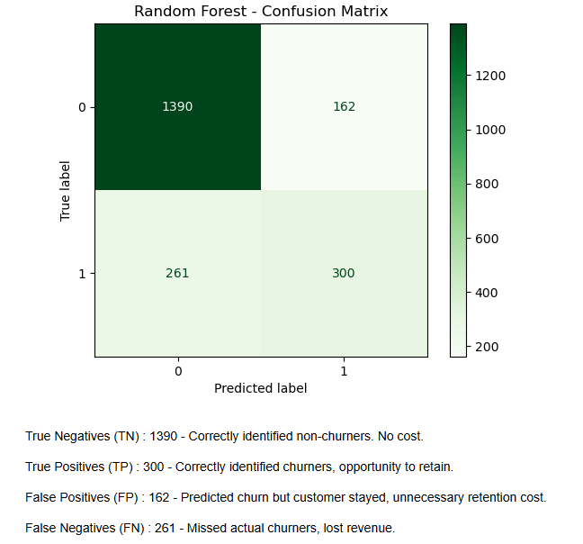
PHASE 1: Random Forest Deployment
Dummy Accuracy Test: 73.45%
Accuracy Test : 79.98%
F1 Score Test: 58.65%
AUROC Test : 85.10%
Misclassification Cost: €55,350
Lowest false positives = efficient retention targeting
Easy to deploy and maintain

Slide 13
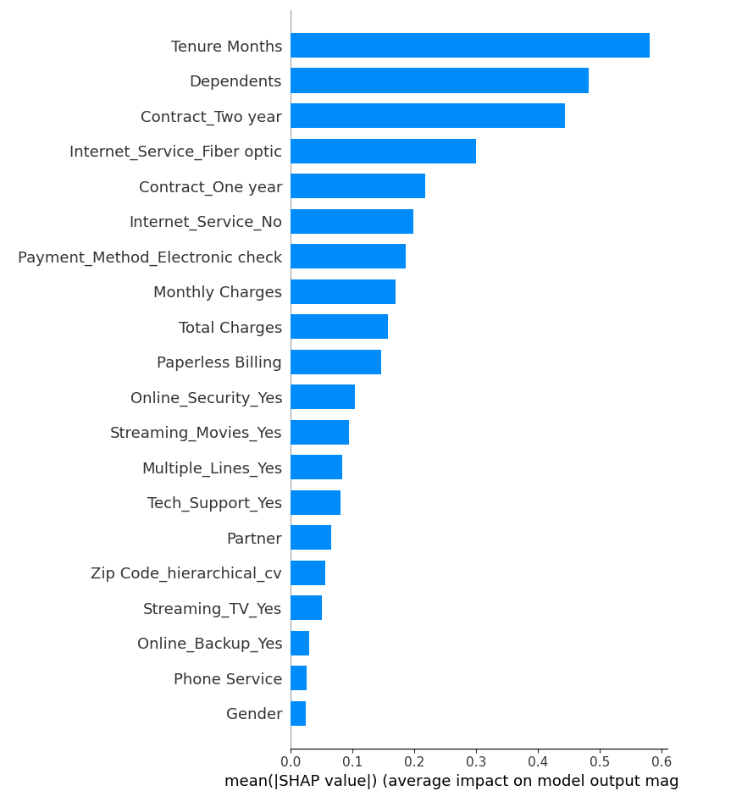
PHASE 2: XGBoost + SHAP Analysis
Dummy Accuracy Test: 73.45%
Accuracy Test: 79.79%
F1 Score Test: 58.58%
AUROC Test: 85.53%
SHAP reveals top churn drivers: Tenure, Dependents, Contract, Internet Service
Enables customer-level explanations
Supports segmentation and campaign design
Ideal for quarterly strategic reviews

Slide 14
Business Insights & Conclusion
Top Churn Drivers:
Month-to-month contracts, fiber optic internet, lack of add-ons (online security, tech support), manual payment methods, senior & single customers without dependents, and early tenure (0–3 months).
High-Risk Profiles:
New customers (<12 months), fiber optic users without protective services, seniors, singles without dependents, and customers in specific high churn zip codes.
Model Performance:
Random Forest: 79.98% accuracy for daily scoring
XGBoost + SHAP: 85.54% AUROC for strategic insights
Robust churn prediction achieved through a hybrid Random Forest–XGBoost model, adaptable across varied customer segments.
Impact:
$55K saved annually, reduced false positives, improved targeting.
Outcome:
Shift from reactive churn response to proactive, personalized retention strategy.

Slide 15
Strategic Recommendations
Retention Focus:
Prioritize onboarding and engagement within the first 3 months to reduce early dropout.
Contract & Payment:
Incentivize upgrades from month-to-month to annual contracts and automatic payment to reduce churn risk.
Product Bundling:
Promote online security, tech support, device protection, and backup as bundled offers to enhance value.
Demographic Tailoring:
Deliver simplified, supportive experiences for seniors and flexible, individualized plans for singles without dependents.
Geographic Targeting:
Address service quality and competitive pressures in high churn zip codes via localized campaigns and service improvements.
Model Utilization:
Use hybrid model churn scores to enable proactive, cost-effective retention campaigns and reduce false positives/negatives.

Slide 16
Implementation Roadmap
Phase 1
Phase 2
Phase 3
Immediate
(0–3 months)
Deploy hybrid model infrastructure
Launch contract migration & fiber service improvement
Promote auto-pay & early tenure engagement
Expansion
(3–9 months)
Personalize campaigns via SHAP
Integrate lifetime value & predictive pricing
Validate with A/B testing
Optimization
(9+ months)
Enable real-time SHAP for VIPs
Explore ensemble models & seasonal trends
Embed churn insights into product, sales & culture

